Slide 1
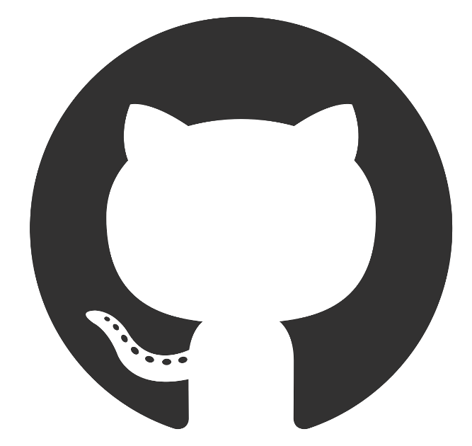




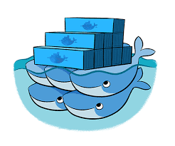


Code pushed to GitHub repository
Update Trello board
Most recent code pulled from GitHub repository
Pull new task from Trello board
Code built via web hook on build server
Coverage reports produced from results of unit testing
Pipeline builds images from latest code pulled from web hook and pushes to Docker Hub
Code moved onto testing
Pipeline configures environment and installs Ansible on master machine
Images pulled from Docker Hub to be used in docker swarm
Ansible configures manager and worker nodes for docker swarm
NGINX used as a reverse proxy
Docker swarm deploys containers across a stack of replicas over multiple VMs

